Slide 1
Chapter 8-ReSOURCE ALLocation
SOFTWARE
PROJECT MANAGEMENT

Slide 2
Schedules
  Activity schedule - indicating start and completion dates for each activity
  Resource schedule - indicating dates when resources needed + level of resources
  Cost schedule showing accumulative expenditure
Notes:
Topics covered
Professional software development
What is meant by software engineering.
Software engineering ethics
A brief introduction to ethical issues that affect software engineering.
Suggested student projects
A brief introduction to each suggested project that can be carried out by students for this course

Slide 3
Resources
These include
  labour
  equipment (e.g. workstations)
  materials
  space
  services
Time: elapsed time can often be reduced by adding more staff
Money: used to buy the other resources
Notes:
Topics covered
Professional software development
What is meant by software engineering.
Software engineering ethics
A brief introduction to ethical issues that affect software engineering.
Suggested student projects
A brief introduction to each suggested project that can be carried out by students for this course

Slide 4
Resource allocation
Identify the resources needed for each activity and create a resource requirement list
Identify resource types - individuals are interchangeable within the group (e.g. ‘VB programmers’ as opposed to ‘software developers’)
Allocate resource types to activities and examine the resource histogram
Notes:
Topics covered
Professional software development
What is meant by software engineering.
Software engineering ethics
A brief introduction to ethical issues that affect software engineering.
Suggested student projects
A brief introduction to each suggested project that can be carried out by students for this course

Slide 5
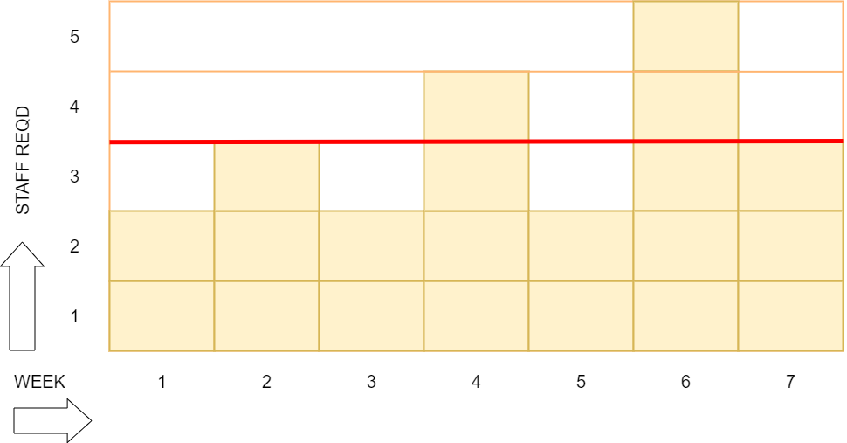
Resource histogram: systems analysts
5
Notes:
Topics covered
Professional software development
What is meant by software engineering.
Software engineering ethics
A brief introduction to ethical issues that affect software engineering.
Suggested student projects
A brief introduction to each suggested project that can be carried out by students for this course

Slide 6
Resource smoothing
It is usually difficult to get specialist staff who will work odd days to fill in gaps – need for staff to learn about application etc
Staff often have to be employed for a continuous block of time
Therefore desirable to employ a constant number of staff on a project – who as far as possible are fully employed
Hence need for resource smoothing
Notes:
Topics covered
Professional software development
What is meant by software engineering.
Software engineering ethics
A brief introduction to ethical issues that affect software engineering.
Suggested student projects
A brief introduction to each suggested project that can be carried out by students for this course

Slide 7
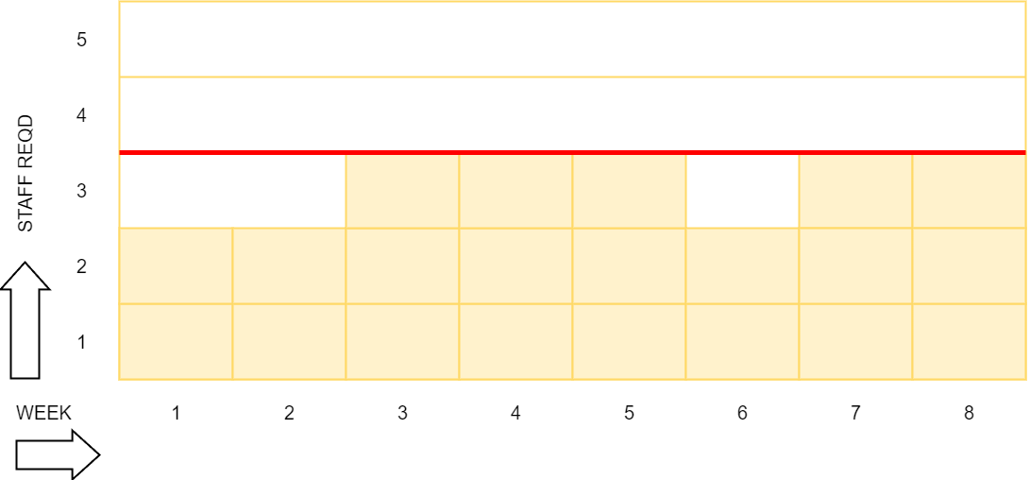
Resource smoothing
Notes:
Topics covered
Professional software development
What is meant by software engineering.
Software engineering ethics
A brief introduction to ethical issues that affect software engineering.
Suggested student projects
A brief introduction to each suggested project that can be carried out by students for this course

Slide 8
Resource clashes
Where same resource needed in more than one place at the same time
can be resolved by:
  delaying one of the activities
    taking advantage ò float to change start date
    delaying start of one activity until finish of the other activity that resource is being used on – puts back project completion
  moving resource from a non-critical activity
  bringing in additional resource – increases costs
Notes:
Topics covered
Professional software development
What is meant by software engineering.
Software engineering ethics
A brief introduction to ethical issues that affect software engineering.
Suggested student projects
A brief introduction to each suggested project that can be carried out by students for this course

Slide 9
Prioritizing activities
There are two main ways of doing this:
Total float priority – those with the smallest float have the highest priority
Ordered list priority – this takes account of the duration of the activity as well as the float – see next overhead
Notes:
Topics covered
Professional software development
What is meant by software engineering.
Software engineering ethics
A brief introduction to ethical issues that affect software engineering.
Suggested student projects
A brief introduction to each suggested project that can be carried out by students for this course

Slide 10
Burman’s priority list
Give priority to:
Shortest critical activities
Other critical activities
Shortest non-critical activities
Non-critical activities with least float
Non-critical activities
Notes:
Topics covered
Professional software development
What is meant by software engineering.
Software engineering ethics
A brief introduction to ethical issues that affect software engineering.
Suggested student projects
A brief introduction to each suggested project that can be carried out by students for this course

Slide 11
Resource usage
need to maximise %usage of resources i.e. reduce idle periods between tasks
need to balance costs against early completion date
need to allow for contingency
Notes:
Topics covered
Professional software development
What is meant by software engineering.
Software engineering ethics
A brief introduction to ethical issues that affect software engineering.
Suggested student projects
A brief introduction to each suggested project that can be carried out by students for this course

Slide 12
Critical path
Scheduling resources can create new dependencies between activities – recall critical chains
It is best not to add dependencies to the activity network to reflect resource constraints:
  Makes network very messy
  A resource constraint may disappear during the project, but link remains on network
Amend dates on schedule to reflect resource constraints
Notes:
Topics covered
Professional software development
What is meant by software engineering.
Software engineering ethics
A brief introduction to ethical issues that affect software engineering.
Suggested student projects
A brief introduction to each suggested project that can be carried out by students for this course

Slide 13
Allocating individuals to activities
The initial ‘resource types’ for a task have to be replaced by actual individuals.
Factors to be considered:
Availability
Criticality
Risk
Training
Team building – and motivation
Notes:
Topics covered
Professional software development
What is meant by software engineering.
Software engineering ethics
A brief introduction to ethical issues that affect software engineering.
Suggested student projects
A brief introduction to each suggested project that can be carried out by students for this course

Slide 14
COST SCHEDULes
Cost schedules can now be produced:
Costs include:
Staff costs
Overheads
Usage charges
Notes:
Topics covered
Professional software development
What is meant by software engineering.
Software engineering ethics
A brief introduction to ethical issues that affect software engineering.
Suggested student projects
A brief introduction to each suggested project that can be carried out by students for this course

Slide 15
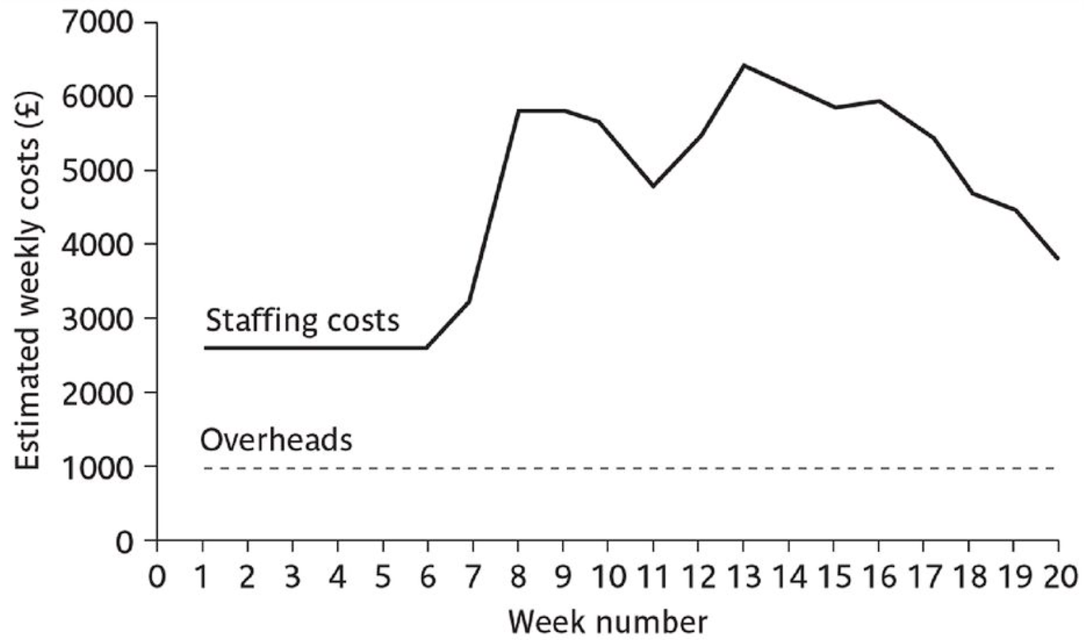
Cost profile
Notes:
Topics covered
Professional software development
What is meant by software engineering.
Software engineering ethics
A brief introduction to ethical issues that affect software engineering.
Suggested student projects
A brief introduction to each suggested project that can be carried out by students for this course

Slide 16
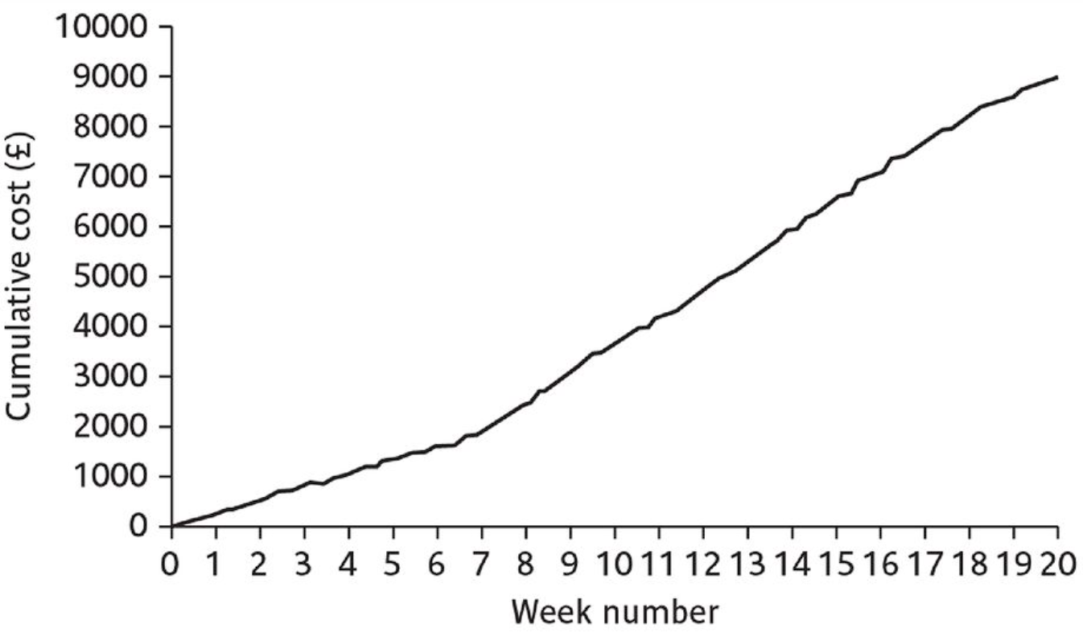
Plans, methods and methodologies
Notes:
Topics covered
Professional software development
What is meant by software engineering.
Software engineering ethics
A brief introduction to ethical issues that affect software engineering.
Suggested student projects
A brief introduction to each suggested project that can be carried out by students for this course

Slide 17
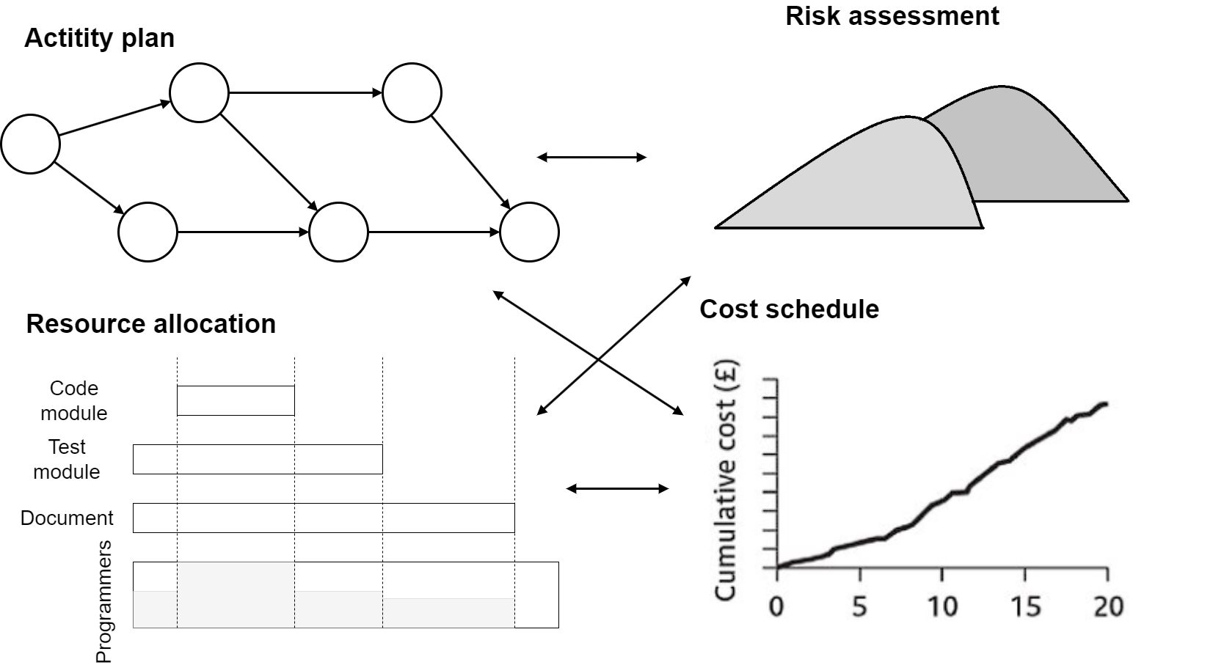
Balancing concerns
Notes:
Topics covered
Professional software development
What is meant by software engineering.
Software engineering ethics
A brief introduction to ethical issues that affect software engineering.
Suggested student projects
A brief introduction to each suggested project that can be carried out by students for this course

